Slide 1
Machine Learning Project - Classification
Group Number: 02
Participants: 1) Dharmil Sangani
2) Anoop Bose

Slide 2
Description:
Problem Statement:
Classification problem to predict whether the client will subscribe to a term deposit.
Dataset:
The dataset contains (41188) and 20 inputs, ordered by date (from May 2008 to November 2010).

Slide 3
Details:
Techniques used:
Logistic Regression
Support Vector Machines
Random Forest Classifier.
Evaluation Metrics:
Accuracy
Precision
Recall
F1-Score

Slide 4

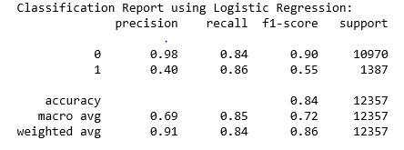
Analysis:
Logistic Regression:
1) Confusion Matrix:
2) Classification Report:

Slide 5

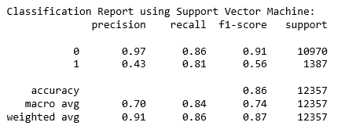
Support Vector Machines:
Confusion Matrix:
2) Classification Report:

Slide 6

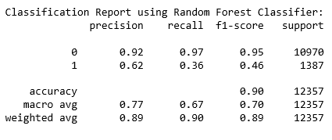
Random Forest Classifier:
Confusion Matrix:
2) Classification Report:

Slide 7
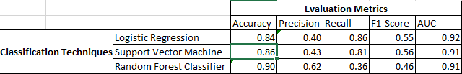
Evaluation of the three models:
We evaluate on the basis of our study of interest ‘Class-1’ i.e. the client will buy the Term deposit.
On the basis of the above analysis, we select ‘Random Forest Classifier’ as the best technique.

